Slide 1





C Data Types
Data Types, Variables, Declaring and Initializing Variables
Programming with C
SoftUni Team
Technical Trainers
Software University
http://softuni.bg

Slide 2

Table of Contents
Data Types
Integer, Floating-Point
Character, String
Declaring and Using Variables
Identifiers
Variables
Literals

Slide 3
How Computing Works?
Computers are machines that process data
Data is stored in the computer memory in variables
Variables have name, data type and value
Example of variable definition and assignment in C
When processed, data is stored back into variables
Variable name
Data type
int count = 5;
Variable value

Slide 4

What Is a Data Type?
A data type:
Is a domain of values of similar characteristics
Defines the type of information stored in the computer memory (in a variable)
Examples:
Positive integers: 1, 2, 3, …
Alphabetical characters: a, b, c, …
Days of week: Monday, Tuesday, …

Slide 5
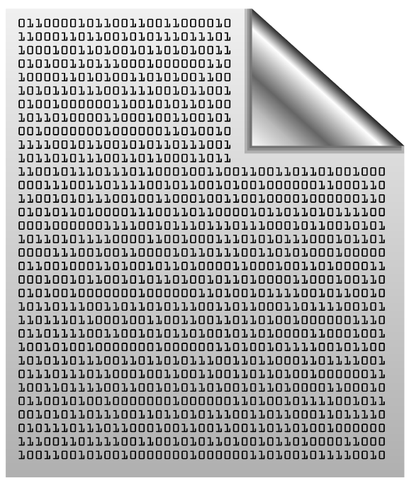

Data Type Characteristics
A data type has:
Name (C keyword)
Size (how much memory is used)
Example:
Characters in C
Name: char
Size: 8 bits (1 byte)
char: sequence of 8 bits in memory
char: 1 byte of memory

Slide 6

Integer Types
int
sbyte
uint
byte
long
short
ulong
ushort
char, short, int, unsigned int, long

Slide 7
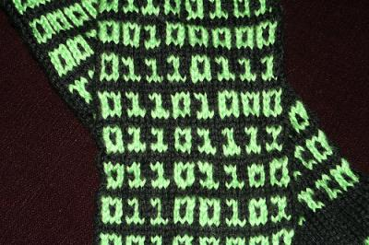
What are Integer Types?
int
Integer types:
Represent whole numbers
May be signed or unsigned
Have range of values, depending on the size of memory used
The default value of integer types is:
0 – for integer types, except
0L – for the long type
short
long

Slide 8
Integer Types
Type | Storage Size | Value Range
char | 8-bit | -128 to 127
unsigned char | 8-bit | 0 to 255
short | 16-bit | -32,768 to 32,767
unsigned short | 16-bit | 0 to 65,535
int | 16- or 32-bit | -2¹⁵+1 to 2¹⁵-1 or -2³¹+1 to 2³¹-1
unsigned int | 16- or 32-bit | 0 to (2*2¹⁵)-1 or 0 to (2*2³¹)-1
long | 32- or 64-bit | -2³¹+1 to 2³¹-1 or -2⁶³+1 to 2⁶³-1
unsigned long | 32- or 64-bit | 0 to (2*2³¹)-1 or (2*2⁶³)-1
long long | 64-bit | -2⁶³+1 to 2⁶³-1
unsigned long long | 64-bit | 0 to (2*2⁶³)-1

Slide 9
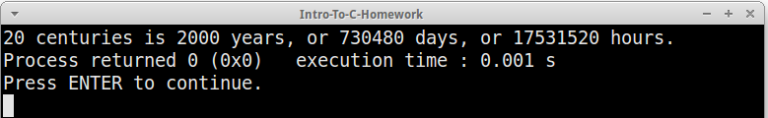
Measuring Time – Example
Depending on the unit of measure we may use different data types:
Note: Type range of int and long varies according to platform!
char centuries = 20; // A small number (up to 255)
unsigned short years = 2000; // A small number (up to 32767)
unsigned int days = 730480; // A large number (up to 4.3 billion)
unsigned long hours = 17531520; // A very big number (up to 18.4*10^18)
printf("%c centuries is %hu years, or %du days, or %lu hours.",
centuries, years, days, hours);

Slide 10

Integer Types
Live Demo
int
ushort
unsigned int
long
short
unsigned long
char

Slide 11

Floating-Point
double
float

Slide 12
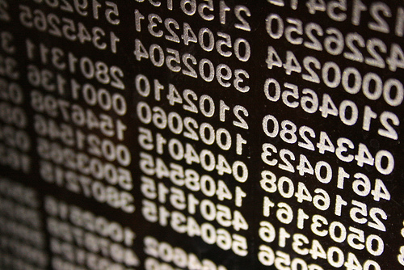
What are Floating-Point Types?
double
Floating-point types:
Represent real numbers
May be signed or unsigned
Have range of values and different precision depending on the used memory
Can behave abnormally in the calculations
float

Slide 13

Floating-Point Types
Floating-point types are:
float (±1.2 × 10⁻³⁸ to ±3.4 × 10³⁸)
32-bit, precision of 6 digits
double (±2.3 × 10⁻³⁰⁸ to ±1.7 × 10³⁰⁸)
64-bit, precision of 15 digits
long double (±3.4 × 10⁻⁴⁹³² to ±1.1 × 10⁴⁹³²)
80-bit, precision of 19 digits
double
float

Slide 14
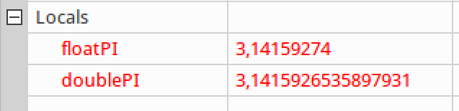
PI Precision – Example
Difference in precision when using float and double:
The default value of floating-point types:
Is 0.0F for the float type
Is 0.0D for the double type
NOTE: The "f" suffix in the first statement!
Real numbers are by default interpreted as double!
One should explicitly convert them to float
float floatPI = 3.141592653589793238f;
double doublePI = 3.141592653589793238d;

Slide 15
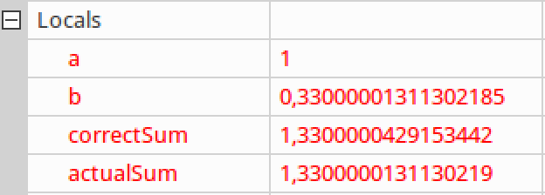
Abnormalities in the Floating-Point Calculations
Sometimes abnormalities can be observed when using floating-point numbers
Comparing floating-point numbers can not be performed directly with the == operator
double a = 1.0f;
double b = 0.33f;
double correctSum = 1.33f;
double actualSum = a + b;

Slide 16

Floating-Point and Decimal Floating-Point Types
Live Demo

Slide 17
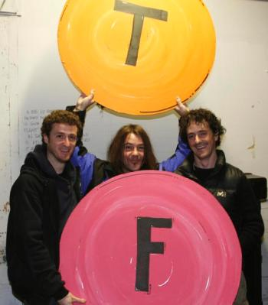
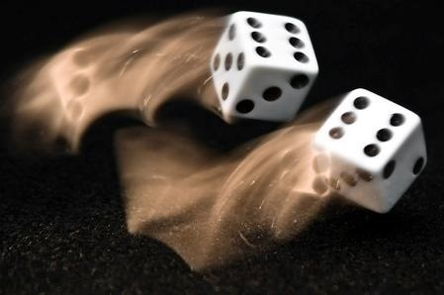
Boolean Type
true
false

Slide 18

The Boolean Type
The Boolean data type:
Has two possible values: true and false
Is useful in logical expressions
In C there is no native boolean data type (no bool keyword)
int variables are used instead (1 for true, 0 for false)
int isHappy = 1;
int hasMoney = 0;

Slide 19
Boolean in C
As an alternative bool can be defined as a macro
Or simply
typedef int bool;
#define true 1
#define false 0
int main()
{
bool isHappy = true;
bool hasMoney = false;
return 0;
}
#include <stdbool.h>
Note: Compiler must support C99 standard

Slide 20

Boolean Type
true
false
Live Demo

Slide 21
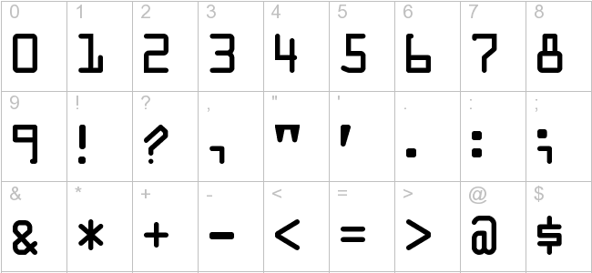
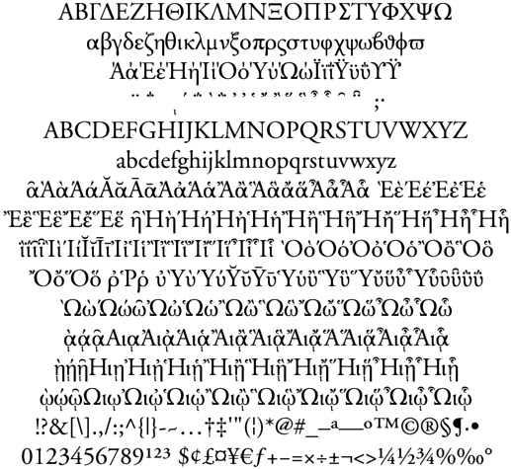

Character Type
char

Slide 22
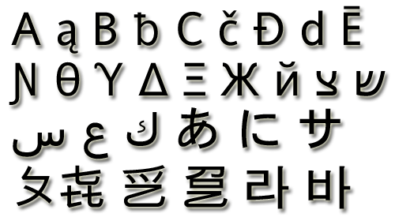
The Character Data Type
The character data type:
Represents symbolic information
Is declared by the char keyword
Can be assigned either a letter or an integer:
char letterA = 'A';
char letterB = 66;
printf("%c", letterA);
printf("%c", letterB);

Slide 23

Character Type
char
Live Demo

Slide 24
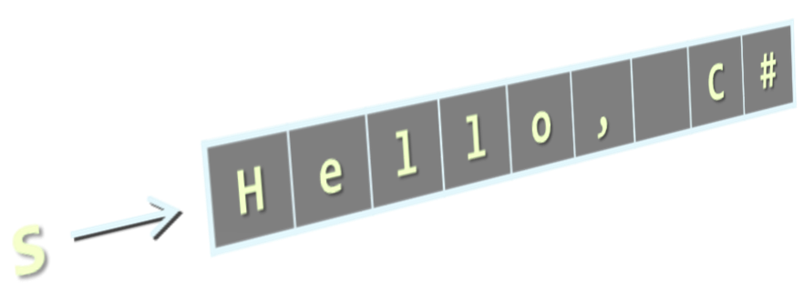
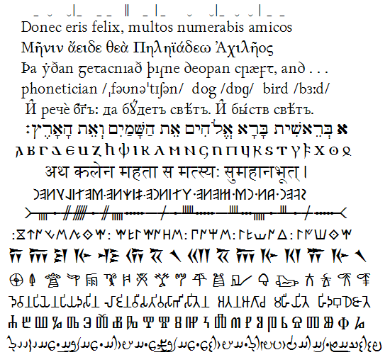
String Type
char*

Slide 25

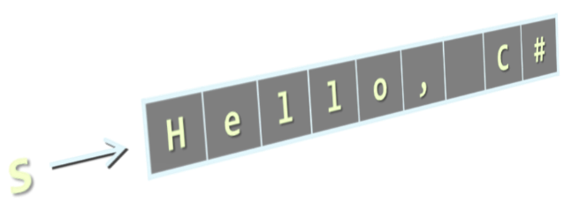
The String Data Type
The string data type represents a sequence of characters
Declared as a char array
Size should be string length + 1
Should always end with null terminator ('\0')
char*
char name[6] = "Pesho";
0 | 1 | 2 | 3 | 4 | 5
80 | 101 | 115 | 104 | 111 | 0
'P' | 'e' | 's' | 'h' | 'o' | '\0'
Null terminator character

Slide 26

String Type
Live Demo
char*

Slide 27

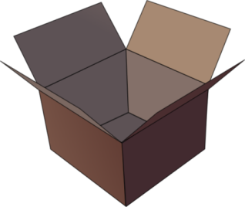




Introducing Variables
length
p
q
name
value
i
str
radius
size

Slide 28
What Is a Variable?
Variables keep data in the computer memory
A variable is a:
Placeholder of information that can be changed at run-time
Variables allow you to:
Store information
Retrieve the stored information
Change the stored information
lastName

Slide 29
Variable Characteristics
A variable has:
Name
Type (of stored data)
Value
Example:
Name: counter
Type: int
Value: 5
counter
5
int counter = 5;
int

Slide 30
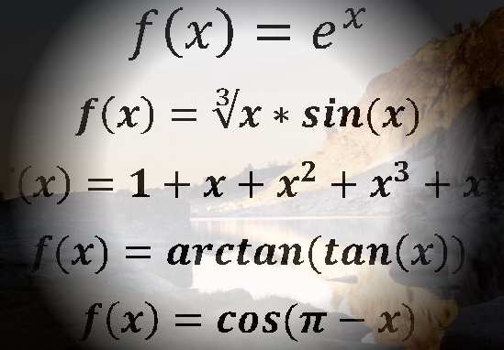
Declaring and Using Variables
counter
5
int

Slide 31
Declaring Variables
When declaring a variable we:
Specify its type
Specify its name (called identifier)
May give it an initial value
The syntax is the following:
Example:
height
200
int
<data_type> <identifier> [= <initialization>];
int height = 200;

Slide 32
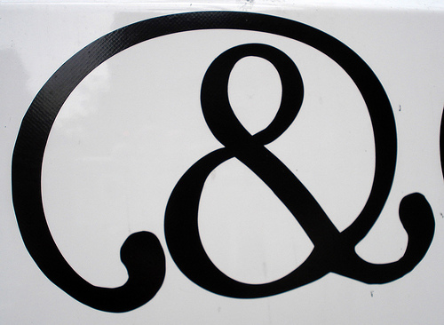
Identifiers
Identifiers may consist of:
Letters (Unicode)
Digits [0-9]
Underscore "_"
Examples: count, firstName, Page
Identifiers
Can begin only with a letter or an underscore
Cannot be a C keyword (like int and void)

Slide 33

Identifiers (2)
Identifiers
Should have a descriptive name
E.g. firstName, not dasfas or p17
It is recommended to use only Latin letters
Should be neither too long nor too short
Note:
In C small letters are considered different than the capital letters (case sensitivity)

Slide 34
Identifiers – Examples
Examples of syntactically correct identifiers:
Examples of syntactically incorrect identifiers:
int New = 2; // here N is capital
int _2Pac; // this identifier begins with underscore _
char greeting[] = "Hello"; // more appropriate name
int n = 100; // undescriptive
int numberOfClients = 100; // good, descriptive name
int numberOfPrivateClientsOfTheFirm = 100; // overdescriptive
int char; // char is a keyword
int 2Pac; // cannot begin with a digit

Slide 35

Assigning Values To Variables
height
200
int

Slide 36
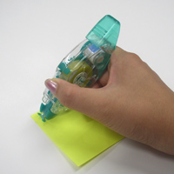
Assigning Values
=
Assigning values to variables
Use the = operator
The = operator
Holds a variable identifier on the left
Value of the corresponding data type on the right
Or expression of compatible type
Could be used in a cascade calling
Where assigning is done from right to left
height
200
int

Slide 37

Assigning Values – Examples
int firstValue = 5;
int secondValue;
int thirdValue;
// Using an already declared variable:
secondValue = firstValue;
// The following cascade calling assigns
// 3 to firstValue and then firstValue
// to thirdValue, so both variables have
// the value 3 as a result:
thirdValue = firstValue = 3; // Avoid cascading assignments!

Slide 38
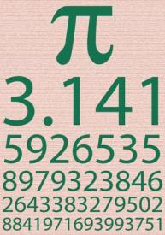
Initializing Variables
Initializing
Means "to assign an initial value"
Must be done before the variable is used!
Two ways of initializing:
By using a literal expression
By referring to an already initialized variable
height
200
int

Slide 39
Initialization – Examples
Example of variable initializations:
// The following would assign the default
// value of the int type to num:
int num; // num = 0
// This is how we use a literal expression:
float heightInMeters = 1.74f;
// Here we use an already initialized variable:
char greeting[] = "Hello World!";
char *message = greeting;

Slide 40
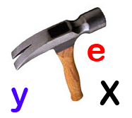

Assigning and Initializing Variables
Live Demo
height
200
int

Slide 41
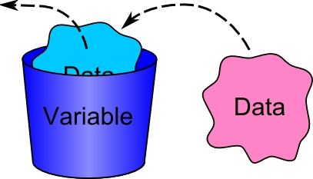
Assigning and Initializing Variables
Exercise

Slide 42
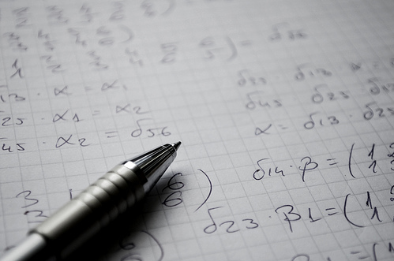
Literals
true
12.76m
null
0xFE
-0.307f
6.02e+23
@"Hi\r\n"
"\uE52B"
2034567324L
3.14159206
"\t\r\n\r\n\r\n"

Slide 43

What are Literals?
Literals are:
Representations of values in the source code
There are several types of literals
Integer
Real
Character
String
The NULL definition

Slide 44
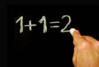
Integer Literals
int
sbyte
uint
long
byte
short
ulong
Examples of integer literals:
The '0x' and '0X' prefixes mean a hexadecimal value
E.g. 0xFE, 0xA8F1, 0xFFFFFFFF
The 'u' and 'U' suffixes mean an unsigned long or unsigned int
E.g. 12345678U, 0U
The 'l' and 'L' suffixes mean a long or unsigned long
E.g. 9876543L, 0L , 1853287583258321ULL
ushort

Slide 45

Real Literals
The real literals:
Are used for values of type float and double
May consist of digits, a sign and "."
May be in exponential notation: 6.02e+23
The "f" and "F" suffixes mean float
The "d" and "D" suffixes mean double
The default interpretation is double

Slide 46


Character Literals
The character literals:
Are used for values of the char type
Consist of two single quotes surrounding the character value:
The value may be:
Symbol
The code of the symbol
Escaping sequence
'<value>'

Slide 47
Escaping Sequences
Escaping sequences are:
Means of presenting a symbol that is usually interpreted otherwise (like ')
Means of presenting system symbols (like the new line symbol)
Common escaping sequences are:
\' for single quote \" for double quote
\\ for backslash \n for new line

Slide 48
Character Literals – Example
Examples of different character literals:
char symbol = 'a'; // An ordinary symbol
symbol = '\''; // Assigning the single quote symbol
symbol = '\\'; // Assigning the backslash symbol
symbol = '\n'; // Assigning new line symbol
symbol = '\t'; // Assigning TAB symbol
symbol = "a"; // Incorrect: use single quotes

Slide 49
Strings Literals
Rules when initializing strings in C:
Size should be string length + 1
Last character is reserved for null terminator character '\0' representing end of string
Strings can be initialized in several ways:
char array declaration:
char firstName[6] = "Petar";
char lastName[] = "Georgiev";

Slide 50
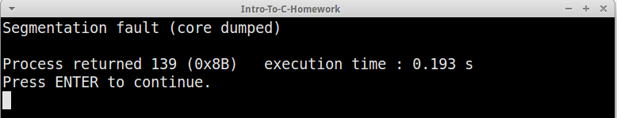
String Literals (2)
Pointer declaration:
Warning: string cannot be modified, will cause segmentation fault because it is located in read-only memory
char* name = "Pesho";
name[0] = 'G'; // Will cause segmentation fault

Slide 51
String Literals (3)
Heap initialization:
Requests 6 bytes from the operating system (OS)
If the OS finds 6 free bytes, it returns a pointer to their address
Copies "Pesho" to the address where the pointer points to
NULL is returned when there is not enough memory
char *firstName = malloc(6);
if (firstName != NULL) {
strcpy(firstName, "Pesho");
// ...
free(firstName);
}
Frees the occupied memory

Slide 52
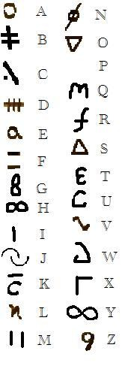
String Literals
Live Demo

Slide 53








C Programming – Data Types
https://softuni.bg/trainings/1212/C-Programming-October-2015

Slide 54
License
This course (slides, examples, demos, videos, homework, etc.) is licensed under the "Creative Commons Attribution-NonCommercial-ShareAlike 4.0 International" license
Attribution: this work may contain portions from
"Programming Basics" course by Software University under CC-BY-SA license

Slide 55






Free Trainings @ Software University
Software University Foundation – softuni.org
Software University – High-Quality Education, Profession and Job for Software Developers
softuni.bg
Software University @ Facebook
facebook.com/SoftwareUniversity
Software University @ YouTube
youtube.com/SoftwareUniversity
Software University Forums – forum.softuni.bg

